Slide 1
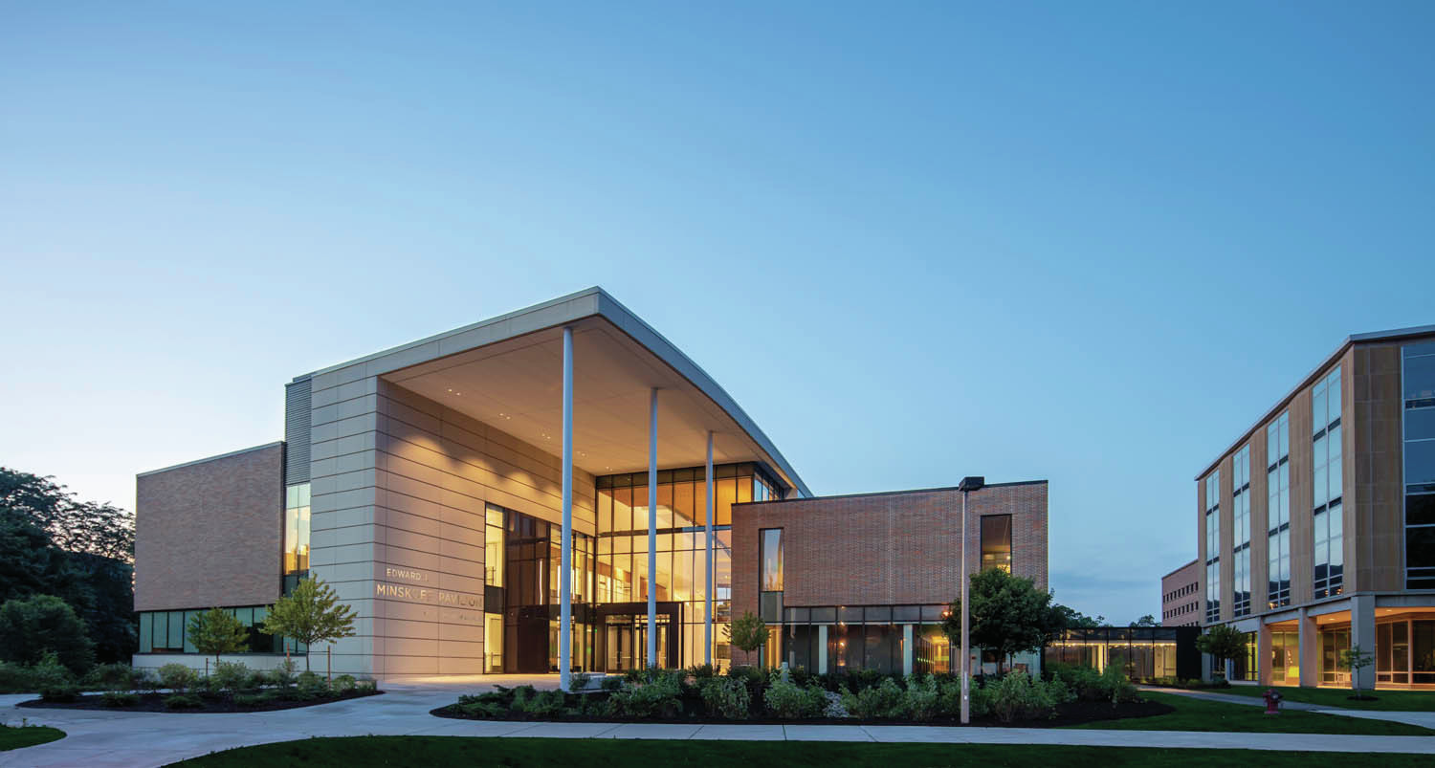
LIST YOUR ORGANIZATION NAME
Image Source: Architect Magazine
Notes:
Image Source: https://www.google.com/url?sa=i&url=https%3A%2F%2Fwww.architectmagazine.com%2Fproject-gallery%2Fedward-j-minskoff-pavilion_o&psig=AOvVaw1mAb5kclucMbEUpWfsZlh1&ust=1604522274648000&source=images&cd=vfe&ved=0CAIQjRxqFwoTCMDajrWd5-wCFQAAAAAdAAAAABAp

Slide 2
MEET THE TEAM
Leadership 2020-2021
NAME NAME
NAME NAME
NAME NAME
NAME NAME
position
position
position
position
LIST YOUR ORGANIZATION’S LEADERSHIP

Slide 3
ABOUT US
EXPLAIN WHAT
YOUR GROUP
IS ABOUT
Our Mission
“We, Broad Student Senate of the Eli Broad College of Business, serve as the liaisons between business students and faculty. We strive to unify and empower students through representing their voices and rights, facilitating events and initiatives, and acting with integrity in all cases.”

Slide 4
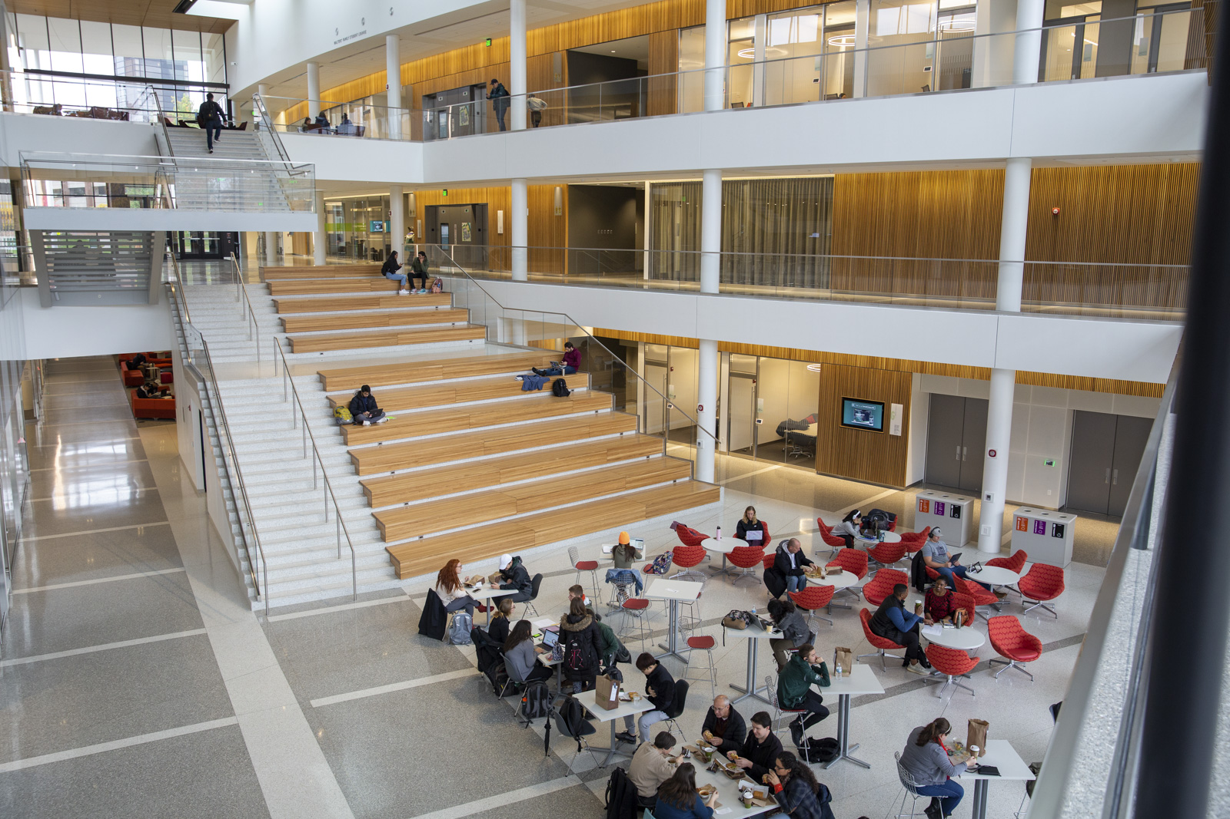
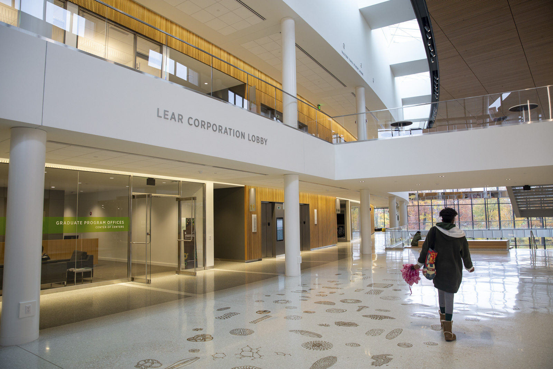
PAST EVENTS
EXPLAIN
YOUR GROUP’S
PAST EVENTS
Image Source: broad.msu.edu

Slide 5
PROJECT/EVENT/TRIP INFORMATION
GIVE DETAIL ABOUT THE PROJECT/EVENT/TRIP YOUR RBSO IS ASKING FUNDING FOR
Sample Schedule
D
A
Y
1
2
3
Add Activities and Details
Add Activities and Details
Add Activities and Details
Add Activities and Details
Add Activities and Details
Add Activities and Details
Add Activities and Details
Add Activities and Details
Add Activities and Details
Add Activities and Details
Add Activities and Details
Add Activities and Details
Notes:
Slide Layout inspired from: https://www.slideteam.net/travel-proposal-template-powerpoint-presentation-slides.html

Slide 6
PROJECT/EVENT/TRIP INFORMATION
GIVE DETAILED INFORMATION
More Detail
Explain to the CCC why your organization needs the funding
Use as many slides as you feel necessary
Mention the benefits of your project/event/trip
Benefit to the Broad College
Benefit to your organization's members

Slide 7
REQUESTED FUNDING
Detail All Financials
Use as many slides as necessary to explain all finances | $0.00
Planned Expense #1 | $0.00
Planned Expense #2 | $0.00
Total Trip Costs | $0.00
Total Amount Requested | $0.00
EXPLAIN HOW MUCH FUNDING YOUR RBSO IS REQUESTING.

Slide 8
QUESTIONS
5 Min. Of Questions From The Committee
THE COMMITTEE WILL ASK YOU QUESTIONS RELEVANT TO YOUR PROPOSAL

